Slide 1
Day 17- Microservice Architecture

Slide 2
Agenda
Monolithic vs. Microservices Architecture
Challenges of monolithic applications
Benefits of Microservices (scalability, maintainability)
12 factor App
SOA, web services
SOLID principles
Designing Microservices
Service identification and boundaries
Communication protocols between microservices (REST, gRPC)
Designing for failure and resilience
Designing a sample application using Microservices architecture
Building a simple Microservice with Spring Boot
Hands-on exercises

Slide 3
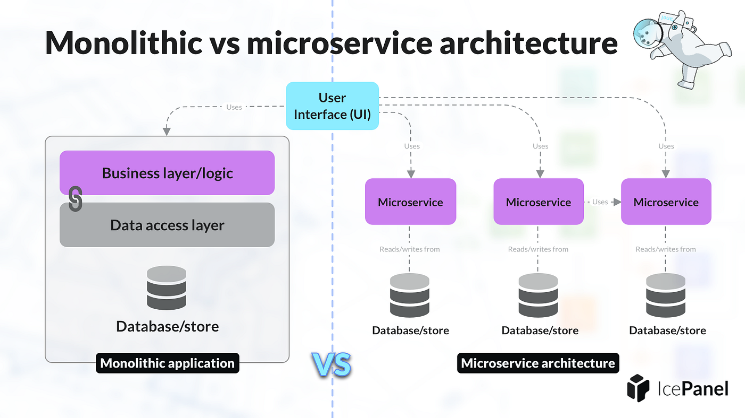
Monolithic vs. Microservices Architecture

Slide 4
Monolithic Architecture
When designing and developing software systems, monolithic and microservices are two common architectural approaches. They differ in terms of structure, scalability, flexibility, and complexity. Here's a comparison of both architectures:
Monolithic Architecture
Definition
A monolithic architecture refers to a single, unified application where all components, like user interface, business logic, and data access, are combined into one large codebase and typically run as a single process.
Characteristics
Single Codebase: The entire application is developed and deployed as a single unit.
Tightly Coupled: All components are interconnected, making it difficult to modify one part without affecting the whole system.
Single Technology Stack: Typically built using a single technology or programming language.
Single Deployment: Changes or updates to any part of the system require redeploying the entire application.

Slide 5
Monolithic Architecture
Advantages
Simpler Development: Easy to develop initially, especially for small projects.
Easy Testing: The system can be tested as a whole in one environment.
Lower Deployment Complexity: There's only one unit to deploy, manage, and monitor.
Performance: Inter-process communication is faster since all components share memory and resources.
Disadvantages
Lack of Flexibility: Scaling is difficult as the entire application must be scaled together, even if only one part needs additional resources.
Tight Coupling: Any small changes or updates require redeploying the entire system, risking downtime or unintended bugs.
Complex to Maintain: Over time, a monolithic system becomes complex and difficult to understand or modify.
Limited Technology Flexibility: You're stuck with one technology stack, making it harder to integrate new tools or technologies.

Slide 6
When to Use Monolithic Architecture
Small or simple applications.
Teams with limited experience or resources to manage distributed systems.
Projects with tight deadlines where simplicity in deployment and management is crucial.

Slide 7
Microservices Architecture
Definition
A microservices architecture breaks down an application into smaller, independent services that are loosely coupled. Each service handles a specific business function, and they communicate with each other over APIs (typically using HTTP/REST, gRPC, or messaging systems).
Characteristics
Independent Services: Each service operates independently, can be developed, deployed, and scaled separately.
Loosely Coupled: Microservices are modular and interact with each other via well-defined interfaces (APIs).
Polyglot Architecture: Different services can be built using different programming languages or technologies.
Distributed: Services can be spread across different servers or even cloud platforms.

Slide 8
Microservices Architecture
Advantages
Scalability: Services can be scaled independently, allowing for better resource optimization.
Technology Flexibility: Developers can use the best tools or technologies for each service, rather than being confined to one stack.
Faster Deployments: Since services are independent, updating or deploying a new feature can happen without redeploying the entire application.
Fault Isolation: Failure in one service won’t bring down the entire system, improving resilience.
Improved Team Autonomy: Different teams can work on different services independently, improving productivity.
Disadvantages
Increased Complexity: Managing multiple services requires handling challenges like network latency, inter-service communication, data consistency, and more.
Operational Overhead: Monitoring, deploying, and managing microservices require sophisticated tools and a DevOps culture.
Data Management: Ensuring data consistency and managing transactions across services can be difficult.
Distributed Systems Challenges: Issues like service discovery, fault tolerance, and latency are common in microservices.

Slide 9
Microservices Architecture
When to Use Microservices Architecture
Large, complex applications that need to scale rapidly.
Teams that can manage distributed systems and have a mature DevOps culture.
Applications that require flexibility in technology choices or independent scaling of components.

Slide 10
Comparison Table: Monolithic vs. Microservices
Aspect | Monolithic Architecture | Microservices Architecture
Structure | Single, unified application | Collection of independent services
Scalability | Scale entire system together | Scale services independently
Development Speed | Faster initial development | Slower due to distributed nature
Deployment | Entire system is redeployed | Each service can be deployed independently
Flexibility | Limited flexibility (one tech stack) | High flexibility (different tech stacks)
Fault Tolerance | System-wide failures | Isolated failures, improved resilience
Operational Overhead | Lower (simpler to manage) | Higher (more components to manage)
Team Autonomy | Lower (tight coupling) | High (teams work independently)
Complexity | Simple to develop, complex to scale | Complex to develop, easier to scale
Use Case | Small to medium-sized applications | Large-scale, complex applications

Slide 11
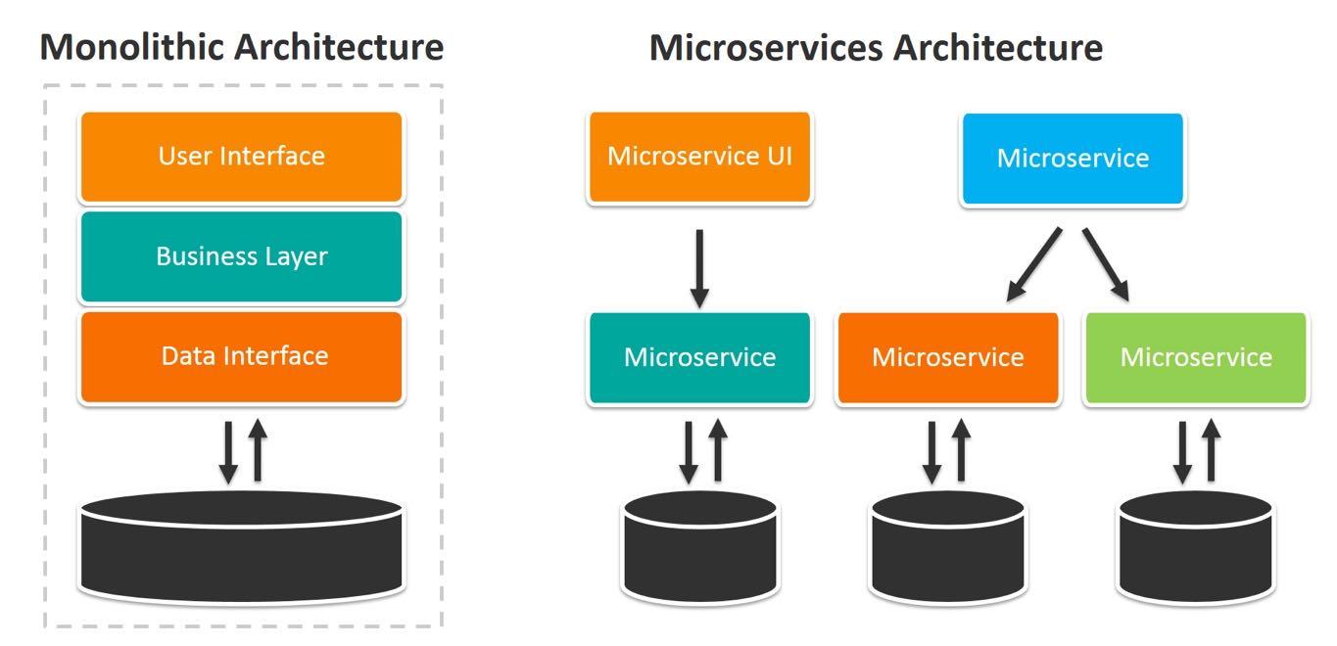

Slide 12
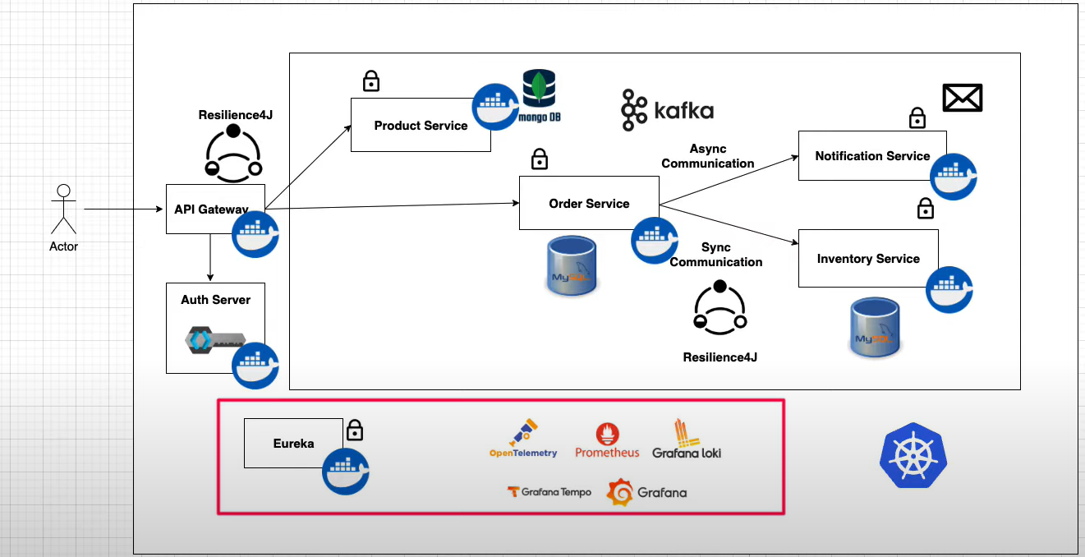

Slide 13
12 factor App
The 12-Factor App is a methodology for building modern, scalable, and maintainable cloud-native applications. It was introduced by developers at Heroku and is widely used as a set of best practices for developing software that can scale efficiently, is easy to manage, and can adapt to the demands of cloud environments. It emphasizes modularity, portability, and maintainability.
Here’s a breakdown of the 12 factors:
Codebase
One codebase tracked in version control, many deploys.
Each app should have a single codebase, which is version-controlled (e.g., Git). Multiple deployments (staging, production, etc.) are different instances of the same codebase.
Best Practice:
Keep a single codebase for the entire app and deploy it to different environments (staging, production).

Slide 14
12 factor App
2. Dependencies
Explicitly declare and isolate dependencies.
The application must declare all its dependencies (e.g., libraries, packages) explicitly in a dependency management system. There should be no implicit reliance on system-wide packages.
Best Practice:
Use tools like npm, pip, Maven, etc., to declare dependencies. Ensure dependencies are isolated using containers or virtual environments.

Slide 15
12 factor App
3. Config
Store config in the environment.
Configuration (such as API keys, database credentials) should be stored in environment variables and kept separate from the codebase.
Best Practice:
Avoid hardcoding config values in the codebase. Use environment variables like DATABASE_URL, API_KEY, etc., to manage environment-specific configurations.

Slide 16
12 factor App
4. Backing Services
Treat backing services as attached resources.
Backing services (such as databases, message queues, or caches) should be treated as external resources and referenced via URLs or connection strings. They should be easy to swap or change without affecting the code.
Best Practice:
Connect to services (e.g., Amazon S3, Redis, MySQL) using environment variables, and avoid hardcoding resource addresses.

Slide 17
12 factor App
Build, Release, Run
Strictly separate build and run stages.
The app's lifecycle should have distinct phases: build (compile code), release (combine build with configuration), and run (executing the app). These stages should not overlap or mix.
Best Practice:
Automate the build, release, and run processes, ensuring that any change to the code or config triggers a new release.

Slide 18
12 factor App
Processes
Execute the app as one or more stateless processes.
The application should run as stateless processes, with no reliance on local storage or memory. State, if needed, should be stored in a database or external cache.
Best Practice:
Avoid storing session data or other persistent information on the local filesystem. Use databases (e.g., PostgreSQL) or caches (e.g., Redis) to maintain state.

Slide 19
12 factor App
Port Binding
Export services via port binding.
Applications should be self-contained and expose services by binding to a port. This is typically used in web applications to make them network-accessible (e.g., via HTTP on port 80).
Best Practice:
Ensure your application runs by binding to a port and provides access via that port (e.g., a web server on port 8080).

Slide 20
12 factor App
Concurrency
Scale out via the process model.
Applications should scale horizontally by adding more processes rather than building complex multithreaded systems. Each process should handle a specific workload, and different types of workloads (e.g., web requests, background jobs) should be handled by different types of processes.
Best Practice:
Design your app to scale by running multiple instances (processes) of the application, not by making each instance more complex.

Slide 21
12 factor App
Disposability
Maximize robustness with fast startup and graceful shutdown.
Processes should start quickly and shut down gracefully to ensure robust deployments and scaling. Apps should be disposable, allowing for rapid scaling, deployment, or restarts without losing data or affecting performance.
Best Practice:
Design processes to be ephemeral, and use graceful shutdowns to handle restarts or scaling.

Slide 22
12 factor App
Dev/Prod Parity
Keep development, staging, and production as similar as possible.
Minimize differences between development, staging, and production environments to reduce deployment issues. Keep the environments as similar as possible, in terms of code, configuration, and infrastructure.
Best Practice:
Use containers (like Docker) to ensure the same environment across development, testing, and production.

Slide 23
12 factor App
Logs
Treat logs as event streams.
Applications should not concern themselves with storing or managing logs. Instead, logs should be treated as event streams and sent to external services for aggregation and analysis.
Best Practice:
Stream logs to a centralized service (like ELK Stack, Splunk, or CloudWatch) for storage and analysis.

Slide 24
12 factor App
Admin Processes
Run admin/management tasks as one-off processes.
Any administrative or maintenance tasks (such as database migrations or batch jobs) should be run as one-off processes, separate from the app’s core processes.
Best Practice:
Run admin tasks like database migrations as separate processes using tools such as heroku run, kubectl exec, or custom scripts.

Slide 25
Benefits of the 12-Factor Approach
Scalability: The app can easily scale horizontally by adding instances.
Portability: Following the 12-factor guidelines makes apps more portable across environments (local, cloud, etc.).
Resilience: These principles emphasize disposability, fault tolerance, and quick recovery, making apps more resilient to failure.
Maintainability: By separating concerns such as configuration, dependencies, and logs, applications are easier to maintain and evolve over time.
The 12-Factor App methodology is especially relevant for cloud-native applications, as it enables easy deployment, scaling, and management in distributed environments.

Slide 26
SOA, web services
Service-Oriented Architecture (SOA) and Web Services are both concepts related to building distributed software systems, but they operate at different levels of abstraction. Let’s explore both in detail and understand their relationship.
Service-Oriented Architecture (SOA)
Definition
SOA is an architectural pattern that promotes the use of loosely coupled, reusable, and interoperable services. These services perform distinct business functions and can communicate with one another over a network, typically using standardized protocols.
Key Characteristics
Loose Coupling: Services are independent, meaning they can be developed, deployed, and maintained separately.
Interoperability: Services interact through well-defined interfaces, allowing for communication between different platforms and programming languages.
Reusable Services: Services are designed to be reused across different applications.
Discoverability: Services can be registered and discovered dynamically at runtime.
Standardized Communication: Typically, services in an SOA communicate using standardized messaging protocols such as SOAP or REST over HTTP.

Slide 27
SOA, web services
Components of SOA
Services: Independent units that encapsulate a business process.
Service Provider: The entity that offers the service and makes it available over the network.
Service Consumer: The entity that requests and uses the service.
Service Contract: A formal agreement that defines the communication interface (input/output messages, protocols) between the service provider and consumer.
Service Registry: A directory where services are registered and can be discovered by consumers.
Advantages of SOA
Reusability: Services can be reused in multiple applications, which reduces redundancy.
Interoperability: Allows for different systems (possibly built in different languages or platforms) to communicate.
Flexibility: Easier to modify or replace individual services without affecting the entire system.
Scalability: Services can be scaled independently based on demand.

Slide 28
SOA, web services
Disadvantages of SOA
Complexity: Implementing SOA can introduce complexity, especially in managing distributed services.
Overhead: Service communication often involves network calls and protocol overhead (especially with SOAP), which can impact performance.
Latency: The distributed nature may introduce latency compared to tightly coupled systems.
When to Use SOA
In large enterprises where multiple applications need to share services.
When integrating heterogeneous systems built on different technologies or platforms.
When a system requires a high degree of reusability and scalability.

Slide 29
Key Differences Between SOA and Web Services
SOA | Web Services
SOA, on the other hand, is the architectural framework that enables a series of those Web services to occur. | A Web service is a "call" to an application, a system, or a hub that asks a question, like: "Does this customer already exist?" By definition, a Web service uses the web to communicate its business question.
You don't deploy "an SOA," rather you deliver these Web services using a SOA framework | Web services need to deploy
Scope: SOA is a broad architectural paradigm and can include various types of services and protocols, not just web services. It emphasizes loose coupling, reusability, and interoperability among services. | Scope: Web Services are a subset of SOA, using protocols such as SOAP (Simple Object Access Protocol) or REST (Representational State Transfer) for service communication.
Protocols: SOA is not tied to specific protocols. It can use various communication protocols, including HTTP, JMS (Java Message Service), and more. | Protocols: Web Services typically use HTTP/HTTPS for communication. SOAP-based web services use XML over HTTP, while RESTful web services use HTTP methods (GET, POST, PUT, DELETE) and can return data in various formats like JSON or XML.

Slide 30
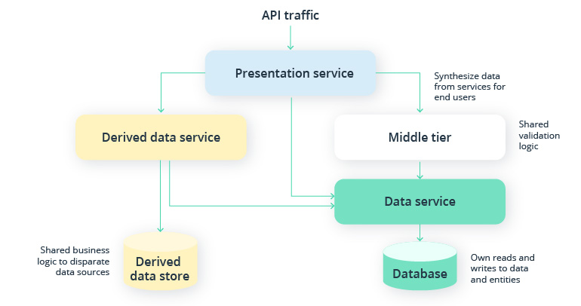
Case study

Slide 31
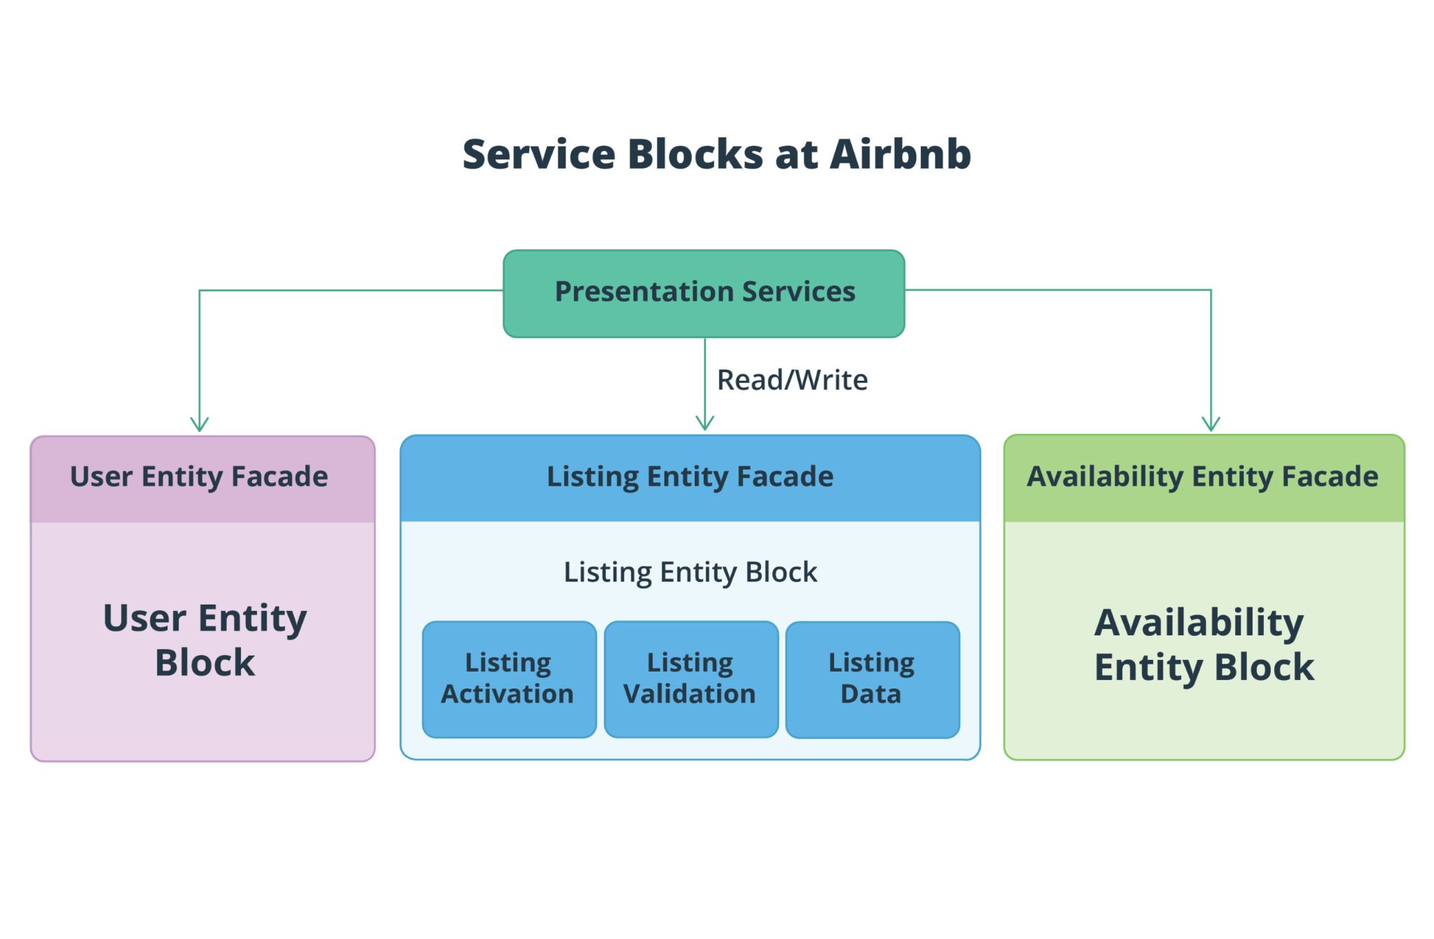
Case study

Slide 32
SOLID principles
The SOLID principles, traditionally applied in object-oriented programming, can also be adapted to microservices architecture to ensure that services are modular, maintainable, and scalable. Here’s how the SOLID principles apply in a microservices context:
Single Responsibility Principle (SRP)
Definition: A class or module should have one, and only one, reason to change.
In Microservices: Each microservice should have a single, well-defined responsibility. It should focus on doing one thing well, such as managing a specific domain or business capability (e.g., user management, billing, inventory). By adhering to SRP, each service is focused, simple, and easier to maintain or update.
Benefits: Reduces complexity, increases the service's clarity, and makes it easier to test and maintain. If business logic changes in one area, only the relevant service needs to be updated.

Slide 33
SOLID principles
Open/Closed Principle (OCP)
Definition: Software entities (classes, modules, functions, etc.) should be open for extension but closed for modification.
In Microservices: Microservices should be extensible without requiring changes to existing services. This is typically achieved through the use of versioning or by adding new services instead of modifying existing ones. New features can be built on top of existing services, allowing them to be extended without breaking existing clients.
Benefits: Encourages backwards compatibility and reduces the risk of introducing bugs by modifying existing services.
Liskov Substitution Principle (LSP)
Definition: Objects in a program should be replaceable with instances of their subtypes without altering the correctness of the program.
In Microservices: In the context of microservices, this translates to ensuring that each service’s interface (API) can be substituted by another service’s implementation without breaking the system. For example, if a service is replaced with an updated version or an alternative implementation, it should behave in a way that doesn’t affect the consumers.
Benefits: Facilitates the deployment of new versions or alternative implementations of a service without disrupting the overall system.

Slide 34
SOLID principles
Interface Segregation Principle (ISP)
Definition: Clients should not be forced to depend on interfaces they do not use.
In Microservices: Microservices should expose small, specific APIs tailored to the needs of consumers, rather than large, generalized ones. Each service should provide only the operations that are relevant to its purpose. This helps to avoid bloated APIs that expose unnecessary functionality.
Benefits: Improves service decoupling, reduces dependencies between services, and ensures that consumers only interact with the specific functionality they need.
Dependency Inversion Principle (DIP)
Definition: High-level modules should not depend on low-level modules. Both should depend on abstractions.
In Microservices: Microservices should depend on abstractions (contracts, interfaces) rather than concrete implementations. This can be achieved by using message brokers, APIs, or abstracted communication mechanisms between services. For example, a service should not rely directly on another service’s implementation but interact via an API or contract that can be easily replaced or modified.
Benefits: Promotes loose coupling between services, allowing for more flexibility and easier changes or replacements without breaking the system.

Slide 35
Summary of SOLID Principles
Summary of SOLID Principles in Microservices:
SRP: Each service handles a single business function.
OCP: Services can be extended without modifying existing logic.
LSP: Services can be replaced without altering the overall system behavior.
ISP: Services expose APIs specific to consumer needs, avoiding unnecessary functionality.
DIP: Services depend on abstractions (APIs, contracts) rather than concrete implementations, ensuring loose coupling.
Applying these principles in microservices architecture helps ensure that services are modular, maintainable, and scalable, which is essential for building a robust and flexible system.

Slide 36
Designing Microservices
Designing microservices involves carefully decomposing a system into smaller, autonomous services that can work together seamlessly. Here's a step-by-step guide to help you design a robust and scalable microservices architecture:
Define the System's Domain (Domain-Driven Design)
Domain-Driven Design (DDD): A foundational step in microservices design is understanding the system’s domain and breaking it down into smaller bounded contexts. These contexts represent different business capabilities or functionalities (e.g., billing, user management, inventory).
Steps:
Identify business functions or capabilities.
Group related functionality into a bounded context.
Each bounded context can become a potential microservice.
Example: An e-commerce system can have services like Order Service, Payment Service, Inventory Service, etc.

Slide 37
Designing Microservices
Identify Microservices Boundaries
Services should be loosely coupled and have high cohesion. Each service should be responsible for a specific business capability and should manage its own data.
Guidelines for Defining Boundaries:
Single Responsibility: A microservice should do one thing well (e.g., Customer Service manages customer data).
Autonomy: Services should operate independently of one another.
Data Ownership: Each service should have its own database (avoiding shared databases) to ensure loose coupling.
Example: A User Service manages user data, and an Order Service handles orders. The two services are decoupled but communicate via APIs.
Define Service Contracts (APIs)
Each microservice should expose a well-defined API that other services or clients can use to interact with it.
RESTful APIs or gRPC are common for microservice communication.
Use OpenAPI (Swagger) to document APIs so that other teams know how to interact with each service.

Slide 38
Designing Microservices
Example: A Product Service API might expose endpoints like:
GET /products/{id}
POST /products
DELETE /products/{id}
4. Establish Communication Patterns
Microservices need to communicate, but excessive synchronous calls can lead to performance bottlenecks.
Communication Patterns:
Synchronous Communication: Services communicate using HTTP/HTTPS, typically with REST or gRPC. Use this pattern when you need real-time responses.
Asynchronous Communication: Services communicate using message brokers (e.g., RabbitMQ, Kafka) or event-driven architecture. This pattern helps to decouple services and improve fault tolerance.
Event-Driven Architecture: Services publish events (e.g., Order Placed) to an event bus, and other services subscribe to events they care about.
Example: When an Order Service places an order, it might publish an event, and the Payment Service listens for the event to initiate payment processing asynchronously.

Slide 39
Designing Microservices
Handle Data Management
Each microservice should own its own data (known as the database per service pattern). This ensures autonomy and prevents tight coupling between services.
Avoid shared databases, but instead use API-based data access between services.
Eventual Consistency: Since each service owns its own data, you may need to adopt an eventual consistency model where services synchronize data asynchronously via events.
Example: The Order Service has its own database for orders, while the User Service maintains a separate database for user profiles.
Ensure Fault Tolerance and Resilience
Microservices can fail independently, so design for failure.
Techniques to Ensure Resilience:
Circuit Breaker Pattern: Prevents a service from trying to call another service if it is known to be down.
Retry and Timeout: Set retries and timeouts to prevent long wait times during communication failures.
Bulkhead Pattern: Isolates services to prevent a failure in one service from cascading to others.
Example: If the Inventory Service is down, the Order Service should not keep retrying indefinitely but instead fall back to a default behavior or cache the request.

Slide 40
Designing Microservices
Security Considerations
API Security: Secure APIs with OAuth2, OpenID Connect, or JWT for authentication and authorization.
Service-to-Service Security: Ensure secure communication between services using mutual TLS (Transport Layer Security) and encrypting data at rest and in transit.
Gateway: Use an API Gateway to route requests, handle authentication, logging, and rate-limiting at a single point.
Example: The Payment Service should authenticate every incoming request from the Order Service via a JWT token or similar mechanism.
Deploy and Manage Services
Microservices architecture is closely associated with containerization and orchestration.
Containerization: Use Docker to package each microservice with its dependencies.
Orchestration: Use Kubernetes or similar tools to manage and scale containers.
Service Discovery: Use tools like Consul or Eureka to automatically discover services within the architecture.
API Gateway: Acts as an entry point, routing client requests to the appropriate microservices.
Example: An API Gateway routes requests to the Order Service, User Service, or Payment Service, depending on the endpoint the client calls.

Slide 41
Designing Microservices
Monitor and Log Services
Centralized Logging: Use centralized logging systems like ELK Stack (Elasticsearch, Logstash, Kibana) or Prometheus + Grafana for metrics and monitoring.
Distributed Tracing: Tools like Jaeger or Zipkin can help trace requests across multiple microservices to understand the flow and pinpoint failures.
Health Checks: Implement health endpoints for each service (e.g., /health) to allow monitoring systems to check the status of the services.
10. Testing Strategies
Unit Tests: Test each service in isolation.
Integration Tests: Ensure that services interact correctly when integrated.
Contract Testing: Tools like Pact can be used to test that the interactions between services are valid by verifying API contracts.
End-to-End Testing: Simulate real user scenarios across multiple services to ensure they work together as expected.

Slide 42
Designing Microservices
Below are the important key points while designing the microservices
Bounded Contexts: Break down the system into independent, business-aligned services.
API Contracts: Define clear communication protocols between services.
Resilience: Design for failure, use event-driven or asynchronous communication where needed.
Autonomous Data: Each service manages its own data, and consistency is handled via events.
Security: Secure service-to-service communication and manage authentication/authorization via gateways and tokens.
Scalability: Containerize and orchestrate services using tools like Docker and Kubernetes.

Slide 43
Communication Protocols between Microservices (REST,gRPC)
gRPC (gRPC Remote Procedure Call) is a high-performance, open-source framework developed by Google for building remote procedure calls (RPC) between services. It allows different systems to communicate over a network as if they were local procedure calls, making it ideal for microservices and distributed systems. Here’s a breakdown of gRPC:
Key Features of gRPC:
Remote Procedure Call (RPC) Framework:
gRPC is based on the concept of Remote Procedure Calls, where a client can directly invoke methods on a remote server as if they were local function calls.
It abstracts the complexity of making network calls and provides a simple interface for developers.
Protocol Buffers (Protobuf):
gRPC uses Protocol Buffers (protobuf), a language-neutral, platform-neutral, and extensible mechanism for serializing structured data.
Protobuf defines the structure of requests and responses, providing a highly efficient binary format, which is smaller and faster compared to JSON or XML.
You define the service and message structure in a .proto file, which gRPC uses to generate client and server code in multiple languages (e.g., Go, Java, Python, C++, etc.).

Slide 44
Communication Protocols between Microservices (REST,gRPC)
Advantages of gRPC:
High Performance: Due to the use of Protocol Buffers and HTTP/2, gRPC provides better performance and lower latency than REST.
Bi-directional Streaming: Full support for streaming data in both directions, making it ideal for real-time applications like chat services, IoT, etc.
Multiplexing: HTTP/2 allows multiplexing of multiple requests/responses over a single TCP connection, improving performance for high-throughput applications.
Multi-language Support: gRPC auto-generates client and server code for multiple programming languages (Java, Go, Python, C#, etc.), making it suitable for polyglot microservices environments.
Disadvantages of gRPC:
Steeper Learning Curve: Compared to REST, gRPC has a more complex setup due to Protocol Buffers and the RPC model.
Limited Browser Support: gRPC does not natively work with browsers without the help of gRPC-Web, limiting its use in web-based applications.
Debugging: Debugging binary payloads (protobuf) can be more challenging than debugging plain JSON in REST.

Slide 45
gRPC is a modern, high-performance RPC framework using HTTP/2 and Protocol Buffers.
It supports multi-language environments, making it suitable for distributed systems like microservices.
Streaming, efficient binary serialization, and strict contract definitions are key advantages.

Slide 46
Introduction to Eureka Server
Eureka Server is a key component of Spring Cloud Netflix, designed to manage microservices in a distributed architecture by acting as a service registry. It allows services to discover each other without hard-coded network addresses, thus enabling dynamic scaling, load balancing, and fault tolerance in a microservices environment.
Key Concepts:
Service Registry:
Eureka Server maintains a central repository of service instances.
Microservices (Eureka clients) register themselves with the Eureka Server.
The registry keeps track of all available instances and their statuses (UP, DOWN, etc.).
Service Discovery:
Clients use Eureka to look up services by name and get the details (e.g., IP, port) of the instances that are running.
This allows clients to interact dynamically with other microservices in the architecture without knowing their physical locations in advance.

Slide 47
Eureka Server
Self-Registration and Deregistration:
When a microservice starts, it registers with Eureka, providing its metadata like service name and address.
If a service becomes unavailable, Eureka marks it as DOWN after a configurable timeout.
Heartbeat Mechanism:
Registered services send periodic heartbeats (renewal requests) to the Eureka Server to inform it that they are still alive.
If a service does not send heartbeats within a certain period, Eureka assumes the service is down and removes it from the registry.
Load Balancing:
Eureka Server works in conjunction with Ribbon (or Spring Cloud LoadBalancer) to provide client-side load balancing. Clients choose a service instance based on a load-balancing algorithm.

Slide 48
Basic Architecture:
Eureka Server:
The central server where all microservices (Eureka clients) register.
Can be deployed as a highly available cluster (peer-aware instances of Eureka Servers).
Eureka Clients:
Microservices that register themselves with Eureka Server to make themselves discoverable.
Can be both service providers and consumers.
Eureka Client Interactions:
Registration: Service providers register with the Eureka server on startup.
Discovery: Service consumers query the Eureka server to find the provider's location.
Heartbeat: Periodic pings from clients to let Eureka know they're still available.
Deregistration: If a service shuts down, it deregisters from Eureka.
How Eureka Enhances Microservices:
Fault Tolerance: By providing automatic failover and rerouting requests to healthy instances.
Dynamic Scalability: Services can be added or removed dynamically without manual reconfiguration.
Centralized Service Management: Simplifies microservice management in large, dynamic environments.

